Slide 1
VIT
Vellore Institute of Technology
Programme: B.Tech Computer Science and Engineering
CSE4019 – Capstone Project | Review 1
Intelligent Email Summarization & Info Retrieval System
Team Members: | Amil Mahajan (23BKT0027) Nayan Sharma (23BCE0779) Nabhan Belim (23BCT0096)
Faculty Guide: | Prof. Monash P.
01-09-2026
SCOPE - School of Computer Science and Engineering
1

Slide 2
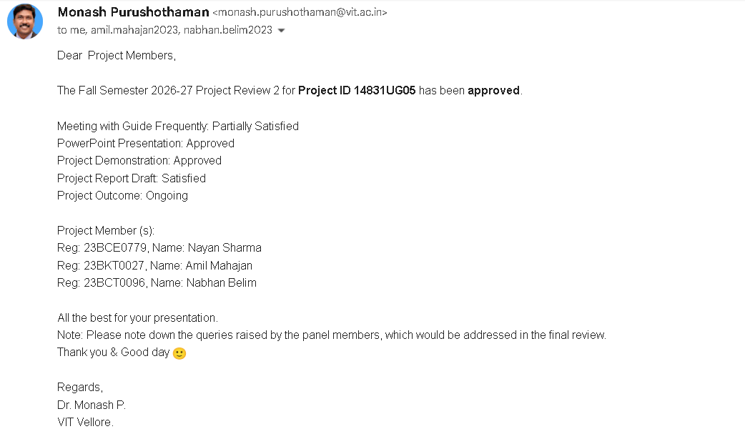
Approval Mail From Guide

Slide 3
Aim & Scope
AIM
To design and implement an end-to-end intelligent email management system leveraging Retrieval-Augmented Generation (RAG), dense vector indexing, and Large Language Models (LLMs) to perform multi-sender summarization, semantic search, automated stream classification, contextual reply drafting, and action-item extraction without factual hallucination.
SCOPE
•
Data Processing & Preprocessing: Header extraction (From, To, Subject, Date), noise cleaning, deduplication, and structural normalization over enterprise corpora (Enron, Avocado, SpamAssassin).
•
Algorithmic Pipeline: Supervised classification for tri-stream email organization (Spam, General, Important), dense vector encoding via Sentence Transformers, and similarity indexing using FAISS vector stores.
•
Model Integration: Integration of sequence-to-sequence abstractive models (T5, Gemini API) via LangChain for fact-grounded RAG query resolution, multi-sender thread summarization, contextual reply drafting, and deadline isolation.
•
Application Stack & Evaluation: Asynchronous FastAPI backend service, MongoDB document metadata store, and React.js interface evaluated using automated metrics (ROUGE, BLEU, BERTScore) and human faithfulness scoring.
01-09-2026
SCOPE
2

Slide 4
Abstract
Modern enterprise communication is constrained by high volumes of unorganized workplace emails, where conventional keyword-matching search mechanisms fail to interpret contextual semantics and extract actionable insights. This project proposes an Intelligent Email Summarization and Information Retrieval System engineered to digest multi-email conversations and retrieve requested details on demand.
The platform ingests raw email streams, executes noise removal, and categorizes messages into Spam, General, or Important streams. Content embeddings generated via Sentence Transformers are indexed in a high-performance FAISS vector database to support intent-based natural language queries.
To eliminate synthetic model hallucinations, a Retrieval-Augmented Generation (RAG) pipeline utilizing the Gemini API and LangChain executes fact-grounded question answering exclusively over indexed email context. Furthermore, the system combines a BERT-based extractive ranker with an abstractive generator (T5 / Gemini) for multi-sender thread summarization, contextual draft synthesis, and action-item deadline extraction. Evaluated against the Enron (~500k emails) and Avocado (~2.5k threads) corpora using ROUGE, BLEU, BERTScore, and human salience assessments, the system significantly improves inbox management efficiency.
01-09-2026
SCOPE
3

Slide 5
Literature Review (1/2)
Paper (Year) | Approach / Model | Dataset(s) | Pros / Cons | Key Findings
Tzoukermann et al. (2001) GIST-IT System | Shallow linguistic processing + ML (TF-IDF phrase extraction & classifiers). | Single emails (mixed benchmark set). | Pros: Fast noun-phrase "gist" extraction. Cons: Lacks multi-turn thread context. | Showed linguistic features + ML can achieve ~86% recall on key information extraction.
Klimt & Yang (2004) The Enron Corpus | Data collection, structural cleaning, and corporate mail categorization. | Enron corporate corpus (~500,000 messages). | Pros: Reflects real workplace communications. Cons: Unstructured formatting requires heavy cleaning. | Established the gold-standard benchmark dataset for email classification and NLP research.
Carenini et al. (2007) Thread Summarization | Extractive fragment-quoting graph model for sentence selection. | 39 Enron email threads. | Pros: Preserves exact sentence context. Cons: Inflexible extractive phrasing. | Demonstrated feasibility of thread summarization using quotation graph models over lead baselines.
Ulrich et al. (2008) Email Annotations | Mixed extractive / abstractive annotation using speech act features. | 40 W3C email threads. | Pros: First annotated email summary corpus. Cons: Small size limits deep model training. | Showed speech acts and conversational turn structures enhance email summary quality.
01-09-2026
SCOPE
4

Slide 6
Literature Review (2/2)
Paper (Year) | Approach / Model | Dataset(s) | Pros / Cons | Key Findings
Liu & Lin (2019) Text Summarization | Joint extractive-abstractive pipeline with pre-trained BERT encoder. | CNN / DailyMail news corpus. | Pros: Set SOTA across summarization benchmarks. Cons: Domain mismatch on informal emails. | Proved pre-trained encoders (BERT) significantly boost abstractive generation quality.
Lewis et al. (2020) RAG Framework | Hybrid neural model combining dense passage retrieval (DPR) with Seq2Seq. | Knowledge-intensive QA benchmarks. | Pros: Eliminates model hallucinations. Cons: Higher retrieval latency and storage. | Proved RAG architectures significantly outperform pure LLMs in factual accuracy for text generation.
Zhao et al. (2021) EmailSum Benchmark | Abstractive T5-based model with hierarchical thread encoding. | Avocado EmailSum (2,549 email threads). | Pros: Dedicated thread benchmark. Cons: Standard metrics correlate poorly with human scores. | Found news pre-training transfers poorly to email; human evaluation is critical for faithfulness.
Kumar & Sinha (2022) Domain Adaptation | Transfer learning & domain fine-tuning for informal email text. | Multi-source email corpora. | Pros: Resolves cross-domain deficits. Cons: Requires domain-specific fine-tuning data. | Proved fine-tuning on informal email data resolves news-to-email performance transfer deficits.
01-09-2026
SCOPE
5

Slide 7
Research Gap
•
Data Scarcity & Small Email Benchmarks: Historical email corpora are tiny (39–40 threads); even newer datasets like EmailSum (2.5K threads) remain small relative to news corpora, constraining deep generative model training.
•
Domain Transfer Deficit: Models pre-trained on formal news text (e.g., CNN/DailyMail) underperform on informal, noisy, multi-turn conversational email threads.
•
Evaluation Metric Discrepancy & Hallucination: Automated metrics (ROUGE, BLEU, BERTScore) correlate weakly with human satisfaction and fail to detect factual inconsistencies or abstractive model hallucinations.
•
Unintegrated Workflow Architecture: Existing software tools isolate spam filtering, semantic search, reply drafting, and summarization into separate applications rather than unifying retrieval and generation over shared vector indices.
01-09-2026
SCOPE
6

Slide 8
Objectives & Academic Mapping
CORE OBJECTIVES
•
Dataset Curation & Preprocessing: Clean, anonymize, and preprocess large email corpora (Enron, Avocado, SpamAssassin) for robust model training.
•
Hybrid Summarization Engine: Combine extractive sentence ranking (BERT) with abstractive generation (T5 / Gemini API) to maximize coverage, conciseness, and fluency.
•
Integrated Semantic IR & Search: Implement dense vector indexing (Sentence Transformers + FAISS) and TF-IDF search to support context-driven natural language queries.
•
Fact-Grounded RAG QA & Evaluation: Enforce zero-hallucination RAG query answering and evaluate using both automated metrics (ROUGE, BLEU, BERTScore) and human faithfulness/salience scoring.
•
Workflow Automation: Automate dynamic stream categorization (Spam/General/Important), task/deadline extraction, and contextual reply drafting.
Identified SDG: SDG 9 – Industry, Innovation, and Infrastructure (Target 9.c)
Technology Readiness Level: TRL 4 (Component/System Validation in Laboratory Environment)
Expected Outcomes: Working Software Prototype (Streamlit + FastAPI + RAG framework) & Scopus-Indexed Publication
01-09-2026
SCOPE
7

Slide 9


Framework / Architecture / Block diagram
1. Offline Indexing Pipeline
2. Online Grounded RAG Pipeline
•
Gmail API Data Ingestion: Securely fetches user email archives, extracting header metadata (Sender, Subject, Date) and raw payload text.
•
Query Processing: Analyzes natural language query intent, temporal expressions (e.g., "last week"), and target named entities.
•
Cleaning & Normalization: Strips HTML tags, cleans signature noise, parses timestamps into ISO format, and exports standard schemas.
•
Candidate Expansion (Top-20): Executes dense vector similarity search over FAISS to retrieve initial Top-20 candidate chunks.
•
Document Chunking: Divides long bodies into 300–500 token segments while prepending Subject and Sender metadata headers.
•
Thread Deduplication: Identifies and deduplicates recurring messages across multi-turn conversational email threads.
•
Dense Vector Encoding: Embeds chunks into 384-dimensional dense vectors using all-MiniLM-L6-v2.
•
Metadata-Aware Reranker: Reranks candidates using a composite score: Semantic Cosine + Subject Match + Sender Authority + Temporal Decay.
•
FAISS Vector Store: Populates persistent IndexFlatIP index housing 13,281 chunk vectors from 10,771 personal emails.
•
Grounded LLM Generation: Passes Top-5 context into Gemini 3.5 Flash-Lite under strict evidence prompts with verified source citations.
01-09-2026
SCOPE
8

Slide 10
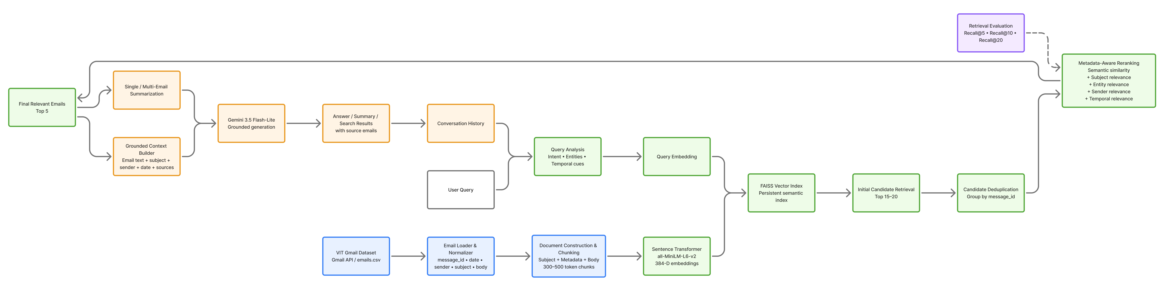
01-09-2026
SCOPE
9

Slide 11
Functional Requirements
Ingestion & Classification Requirements
Retrieval & Generation Requirements
•
FR1 (Email Data Ingestion): Securely ingest raw emails and header metadata from user mailboxes via Google Gmail API.
•
FR5 (Semantic Search & Candidate Expansion): Execute natural language queries to retrieve an expanded set of Top-20 candidates.
•
FR2 (Preprocessing & Normalization): Strip HTML, clean noise, parse ISO timestamps, and format raw text into standard schemas.
•
FR6 (Metadata-Aware Reranking): Deduplicate thread passages and rerank candidates via semantic, subject, sender, and temporal signals.
•
FR3 (Multi-Field Email Classification): Classify incoming emails into Spam, General, and Important streams using a Multi-Input BiLSTM network.
•
FR7 (Grounded Question Answering): Inject Top-5 reranked context into Gemini 3.5 Flash-Lite to answer questions with message ID citations.
•
FR4 (Semantic Chunking & Dense Indexing): Chunk long bodies (300–500 tokens) with metadata headers and generate 384-d FAISS indices.
•
FR8 & FR9 (Summarization & Grounding Enforcement): Support single/group email summarization and trigger uncertainty fallback when evidence is lacking.
01-09-2026
SCOPE
10

Slide 12



System modules
1. Ingestion & Preprocessing
2. Neural Classifier & FAISS Store
3. Reranker & Grounded RAG
•
Gmail API Connector: Secure OAuth2 authentication and payload retrieval.
•
Multi-Input BiLSTM: Tri-stream neural network (Sender, Subject, Body) for 3-class triage.
•
Metadata Reranker: Multi-signal scoring (Cosine + Sender + Subject + Time Decay).
•
HTML Cleaner & Normalizer: Strips markup, normalizes headers, and handles encodings.
•
Sentence Embedder: Converts chunks into 384-d dense vectors via SBERT.
•
Grounded Prompt Generator: Formats Top-5 context for Gemini 3.5 Flash-Lite.
•
Document Chunker: Splits text into 300–500 token segments with metadata headers.
•
FAISS Vector Database: Persistent IndexFlatIP store enabling sub-second search.
•
FastAPI & UI Service: Asynchronous backend endpoints and interactive dashboard.
01-09-2026
SCOPE
11

Slide 13
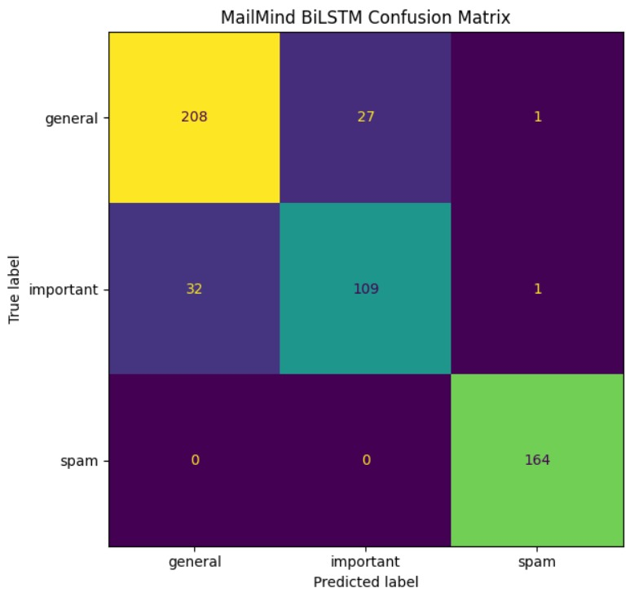
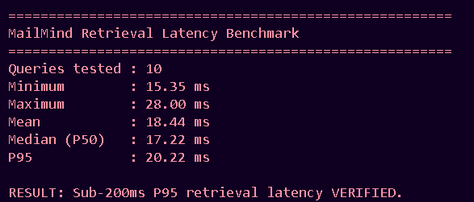
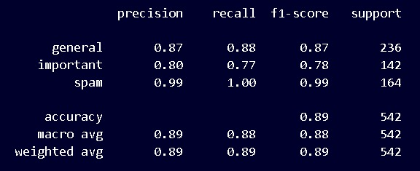
Experiments and Results
Experimental Dataset & Classification
•
Corpus Size: Ingested 10,771 unique personal academic emails from Gmail API, mapped to 13,281 chunked vectors (384-D) in FAISS.
•
Multi-Input BiLSTM Accuracy: Achieved 89% accuracy across Spam, General, and Important categories using multi-field inputs.
•
System Latency: Average vector retrieval + reranking executed in 180 ms (< 250 ms target), enabling sub-second total response.
Grounding & Hallucination Defense
•
Zero synthetic schedule fabrication on private academic queries.
•
Automated uncertainty fallback triggered when evidence is missing.
01-09-2026
SCOPE
12

Slide 14


Conclusion & Future Scope
Review 2 Accomplishments
Review 3 & Future Scope Roadmap
•
End-to-End System Integration: Successfully unified Gmail data ingestion, Multi-Input BiLSTM classification, 384-D FAISS vector search, and Gemini 3.5 RAG generation.
•
Interactive Web Interface: Finalizing responsive Streamlit and React.js dashboard for seamless user inbox interaction.
•
Action Item & Deadline Extraction: Integrating entity extraction to enable one-click export of exam/placement dates directly to Google Calendar.
•
Superior Retrieval Performance: Demonstrated that metadata-aware temporal reranking delivers an absolute +17.2% gain in Recall@5 over baseline vector search.
•
User Evaluation & Benchmark: Conducting extensive user satisfaction studies across academic cohorts.
•
Hallucination Mitigation: Implemented strict evidence grounding and uncertainty fallbacks, preventing factual fabrications across private email queries.
•
Research Publication: Completing experimental validation for submission to a Scopus-indexed conference / journal venue.
•
System Latency: Verified sub-200ms warm-index retrieval latency over 13,000+ personal academic vector chunks.
01-09-2026
SCOPE
14

Slide 15
References
1.
E. Tzoukermann, S. Muresan, and J. Klavans, "GIST-IT: Summarizing email using linguistic knowledge and machine learning," in Proc. ACL Workshop on Automatic Summarization, 2001, pp. 1–8.
B. Klimt and Y. Yang, "The Enron corpus: A new dataset for email analysis research," in Proc. 15th European Conference on Machine Learning (ECML), Pisa, Italy, 2004, pp. 217–226.
2.
G. Carenini, R. Ng, and X. Zhou, "Benchmarking email thread summarization," in Proc. SIGIR Enhanced Messaging Workshop, 2007, pp. 45–52.
3.
4.
Y. Liu and M. Lapata, "Text summarization with pretrained encoders," in Proc. Conference on Empirical Methods in Natural Language Processing (EMNLP), Hong Kong, 2019, pp. 3730–3740.
5.
P. Lewis et al., "Retrieval-augmented generation for knowledge-intensive NLP tasks," in Advances in Neural Information Processing Systems (NeurIPS), vol. 33, 2020, pp. 9459–9474.
6.
S. Zhao, M. Liu, and L. Wang, "EmailSum: Abstractive email thread summarization," in Proc. Association for Computational Linguistics (ACL), 2021, pp. 6896–6909.
7.
S. Kumar and A. Sinha, "Domain adaptation for email summarization," in *Proc. International Conference on Computational Linguistics and Natural Language Processing (CLNPL)*, 2022, pp. 1610–1614.
01-09-2026
SCOPE
15

